Slide 1
Medgar Evers: Contribution to the Civil Rights Movement

Slide 2
Introduction
Medgar Wiley Evers was born July 2, 1925, in Decatur, Mississippi
World War 2 Veteran, civil rights activist, NAACP’s first field secretary in Mississippi
Major contributions: NAACP leadership, integration of the University of Mississippi, pursuit of justice for Emmet Till
Evers’ courageous leadership helped propel the civil rights movement in Mississippi and throughout the country

Slide 3
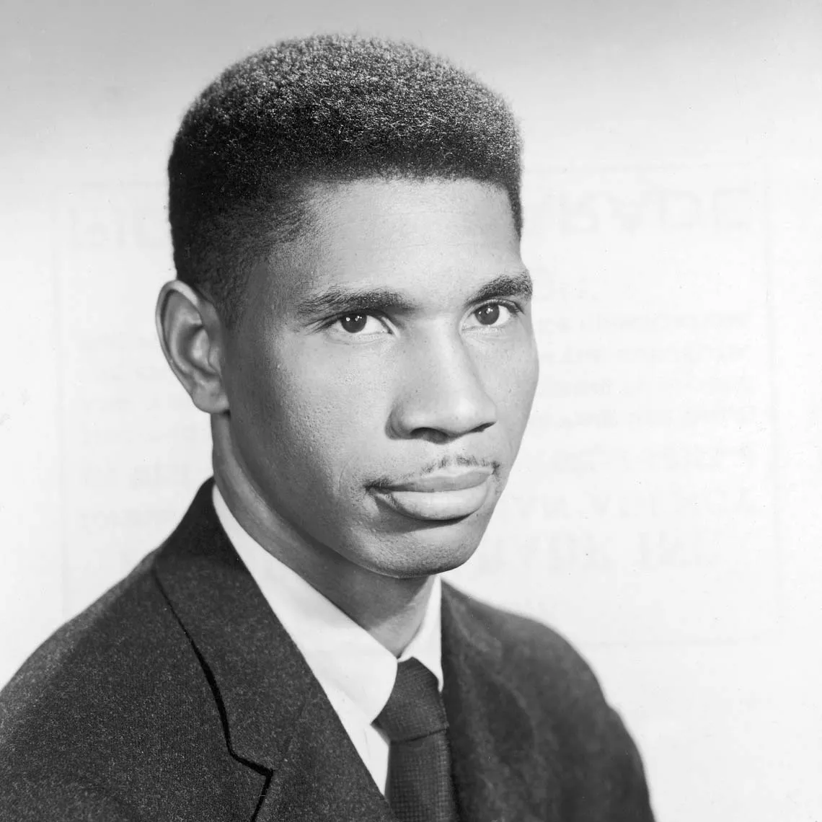
NAACP Leadership in Mississippi
Appointed the first NAACP Field secretary in Mississippi in 1954.
Established new NAACP chapters, organized voter registration drives, and led protests against segregation.
Investigated racial violence, including lynchings and murders, and provided legal and financial support to activists.
Created an underground network of activists nationwide despite threats and danger.

Slide 4
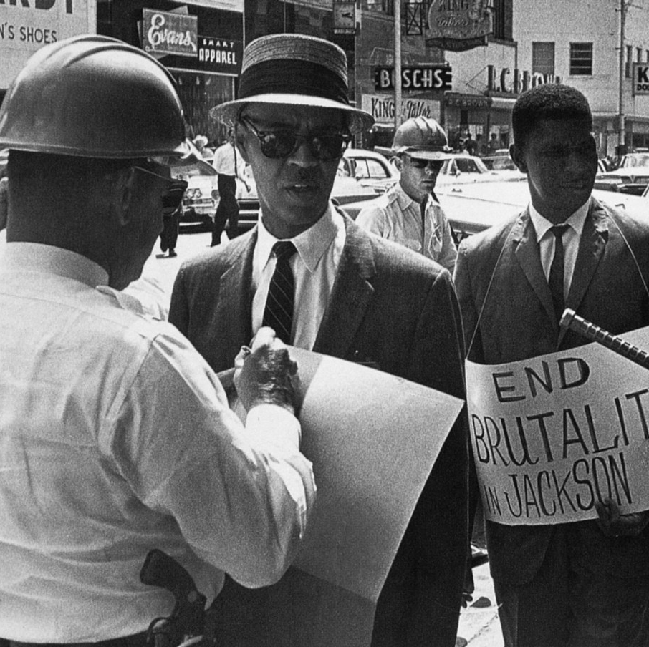
Efforts to Integrate the University of Mississippi
Applied for admission to the University of Mississippi law school in 1954 but was denied due to segregation.
Worked closely with the NAACP legal team to support James Meredith’s successful enrollment in 1962, overcoming violent opposition and riots.
This integration was pivotal in the civil rights movement, facing down fixed segregationist resistance.

Slide 5
Pursuit of Justice for Emmett Till
Played a key role in investigating the 1955 brutal murder of 14-year-old Emmett Till.
Helped secure NAACP involvement, gathered eyewitness testimony, and aided the safe escape of witnesses from Mississippi to protect them from retaliation.
Till’s murder and Evers’ efforts exposed racial terrorism nationally and fueled civil rights activism.

Slide 6
Legacy and Impact
Evers’ assassination in 1963 galvanized the civil rights movement, leading to national outrage and legislative progress.
His leadership inspired voter registration and desegregation efforts across Mississippi and the South.
Following recognition includes the NAACP Spingarn Medal and the naming of Medgar Evers College in Brooklyn, NY.
His widow, Myrlie Evers-Williams, continued his legacy as a civil rights leader and NAACP chairwoman.

Slide 7
Citation Continue
Payne, Charles M. "Medgar Evers: Mississippi Martyr." The Journal of Southern History,
vol. 79, no. 2, 2013, pp. 532-533. eLibrary; History Study Center; ProQuesCentral, https://login.proxy035.nclive.org/login?url=https://www.proquest.com/scholarly-journals/medgar-evers-mississippi-martyr/docview/1353072823/se-2

Slide 8
Citation
Brown, DeNeen L. "At Medgar Evers's Home, a Testament to Price He Paid." The Washington Post, 14 June 2023. eLibrary; ProQuest Central, https://login.proxy035.nclive.org/login?url=https://www.proquest.com/newspapers/at-medgar-everss-home-testament-price-he-paid/docview/2825312429/se-2

Slide 9
Citation Continue
Wikipedia contributors. (2025, April 2). Medgar Evers. In Wikipedia, The Free Encyclopedia. Retrieved 01:16, April 16, 2025, from https://en.wikipedia.org/w/index.php?title=Medgar_Evers&oldid=1283663400
("Dave") Dennis, David J, SR. "Unsung Heroes of 1964 Mississippi Freedom Summer."
Southern Quarterly, vol. 52, no. 1, 2014, pp. 44-50,237. ProQuest Central, https://login.proxy035.nclive.org/login?url=https://www.proquest.com/scholarly-journals/unsung-heroes-1964-mississippi-freedom-summer/docview/1658371480/se-2

